Slide 1
ROBOTICS GROUP PROJECT
UR5e
GROUP5
19222003 Gao Ruiqi
19222004 Gong Luyi
19222006 Hong Yun
19222015 Sun Yifan

Slide 2
Contents
Robot
System
Kinemetic
Model
Assembly
Process
Part One
Part Two
Part Three

Slide 3
Robot
System
Part One

Slide 4
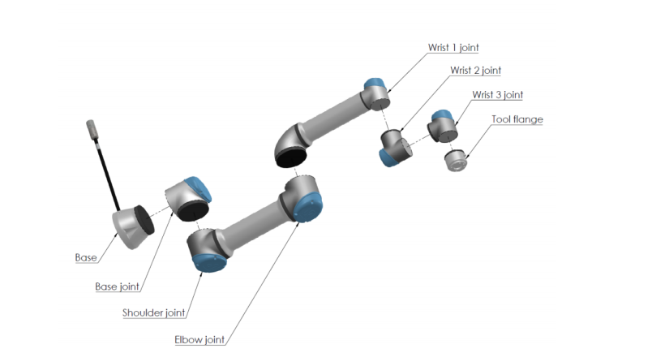
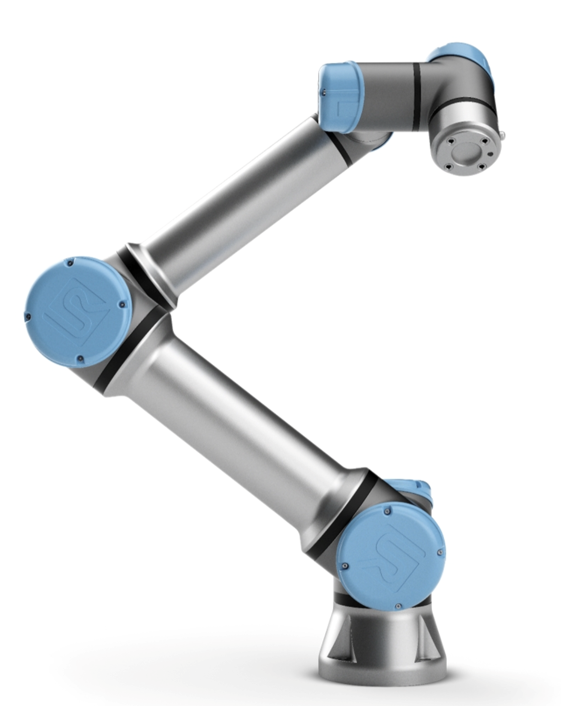
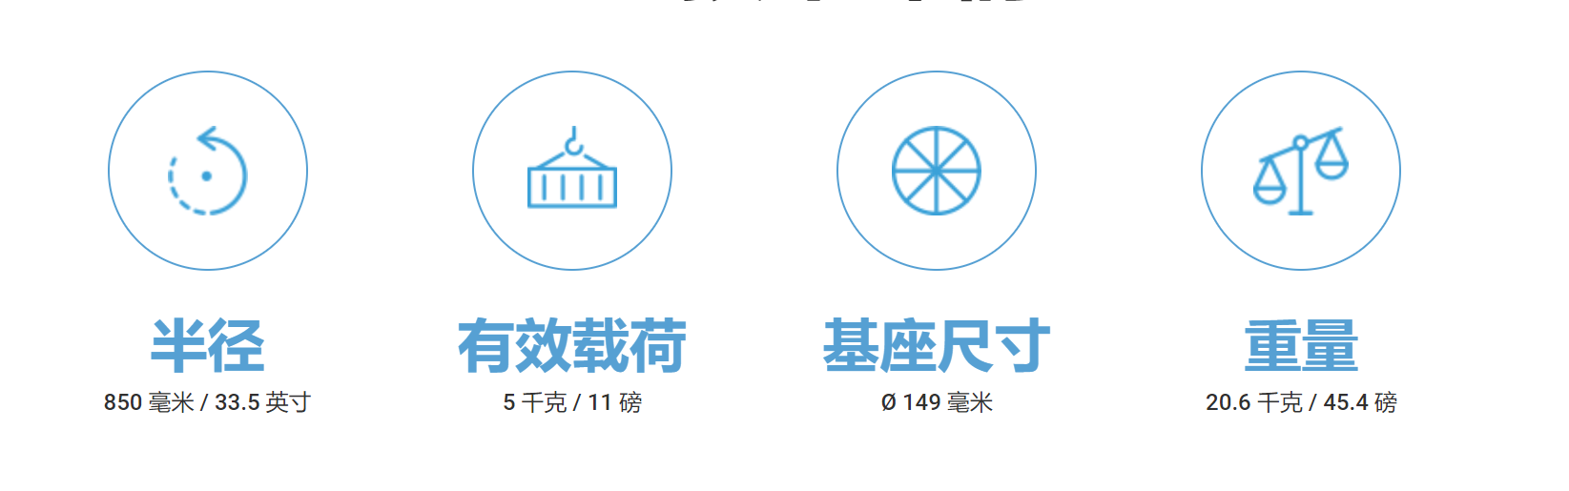
N4
N5
N6
N7
N1
N2
N3
02.The number and
type of the joints
01.Degree of freedom
Number：6
Type：revolute pair
m=6 N=7 J=6 fi=1
DOF=6

Slide 5
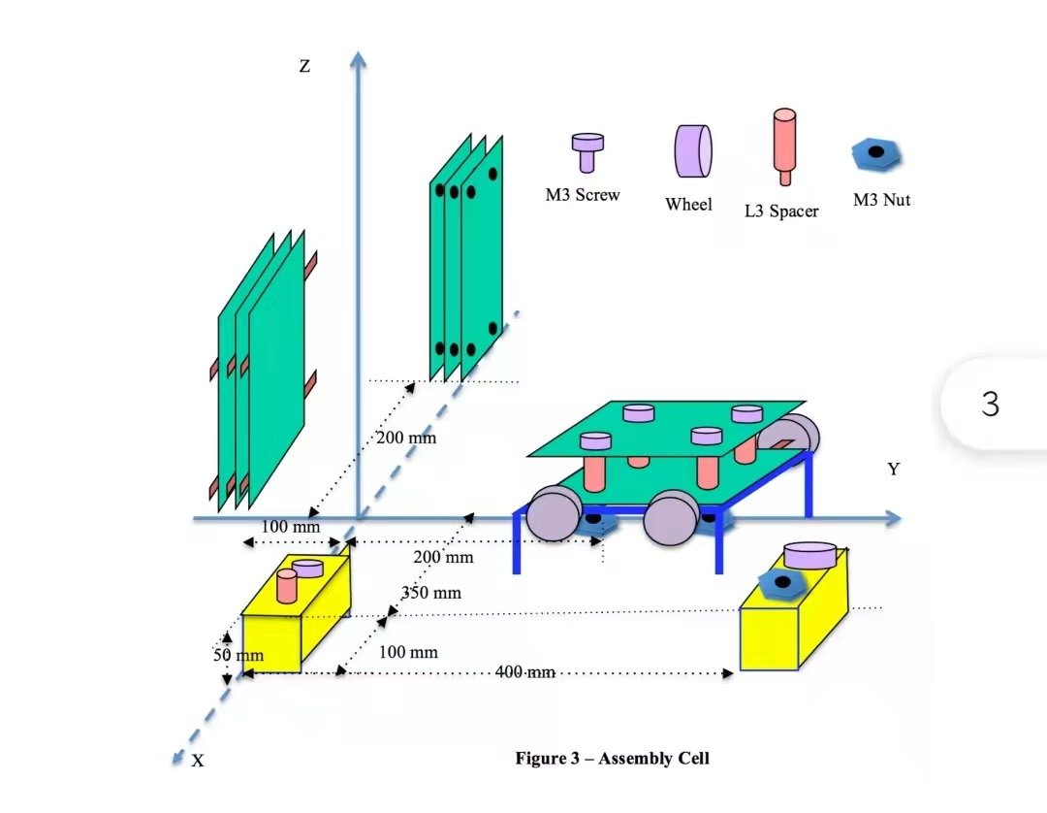
03 Base Position
Base position(0,0,0)

Slide 6
04 The Length of the Links
links | length(mm)
1 | 0
2 | 0
3 | 303.03
4 | 244.96
5 | 0
6 | 0
7 | 0
244.96mm
303.03mm

Slide 7
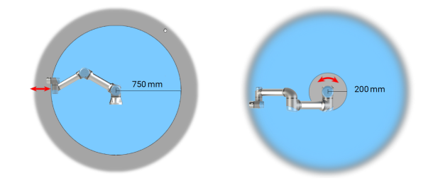
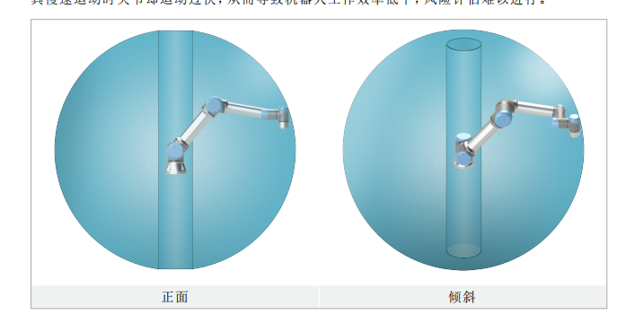
05 The Horizontal and Vertical reaches
06 The Joint Space Work
1500mm
side view
400mm
1500mm
top view

Slide 8
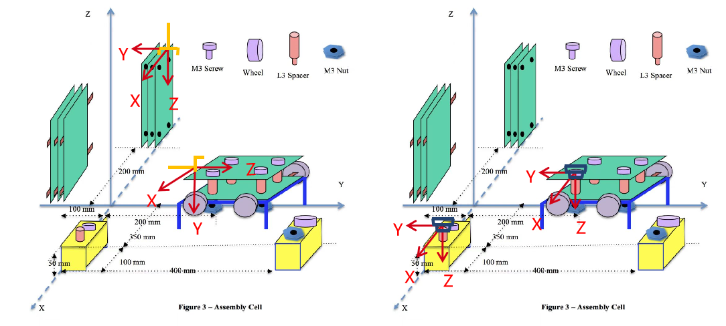
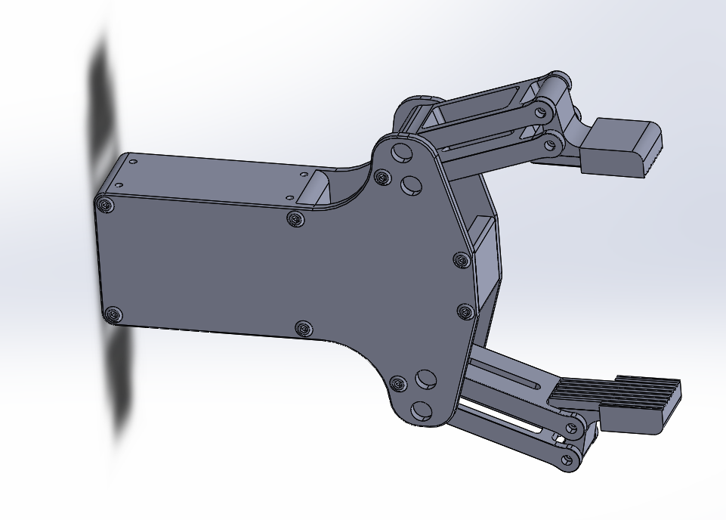
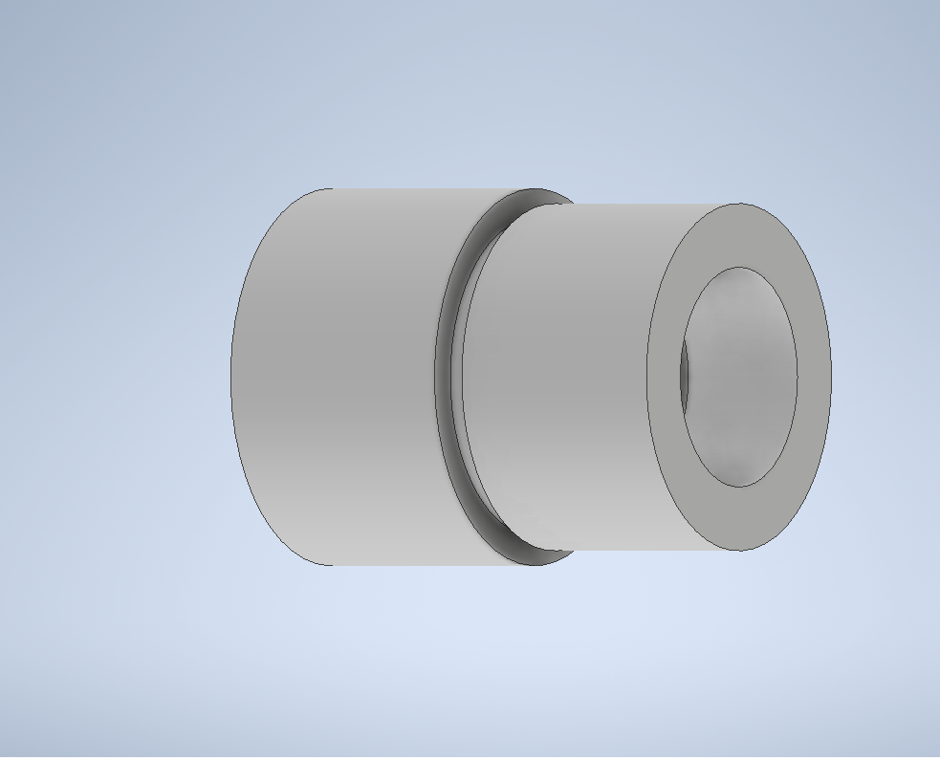
The Orientation and Location of the Tools
T11
T11 | 1 | 0 | 0 | -0.33 | T31 | 1 | 0 | 0 | 0.42
 | 0 | -1 | 0 | -0.01 |  | 0 | -1 | 0 | 0.025
 | 0 | 0 | -1 | 0.5 |  | 0 | 0 | -1 | 0.065
 | 0 | 0 | 0 | 1 |  | 0 | 0 | 0 | 1
T12 | 1 | 0 | 0 | 0 | T32 | 1 | 0 | 0 | 0.08
 | 0 | 0 | -1 | 0.70 |  | 0 | -1 | 0 | 0.25
 | 0 | 1 | 0 | 0.09 |  | 0 | 0 | -1 | 0.09
 | 0 | 0 | 0 | 1 |  | 0 | 0 | 0 | 1
T32
T12
T31
task1
task3

Slide 9
Kinemetic
Model
PartTwo

Slide 10
Kinemetic
Model
The Coordinate Frames
The Kinematic Parameters
The Arm Equations
By hand
Using Matlab

Slide 11
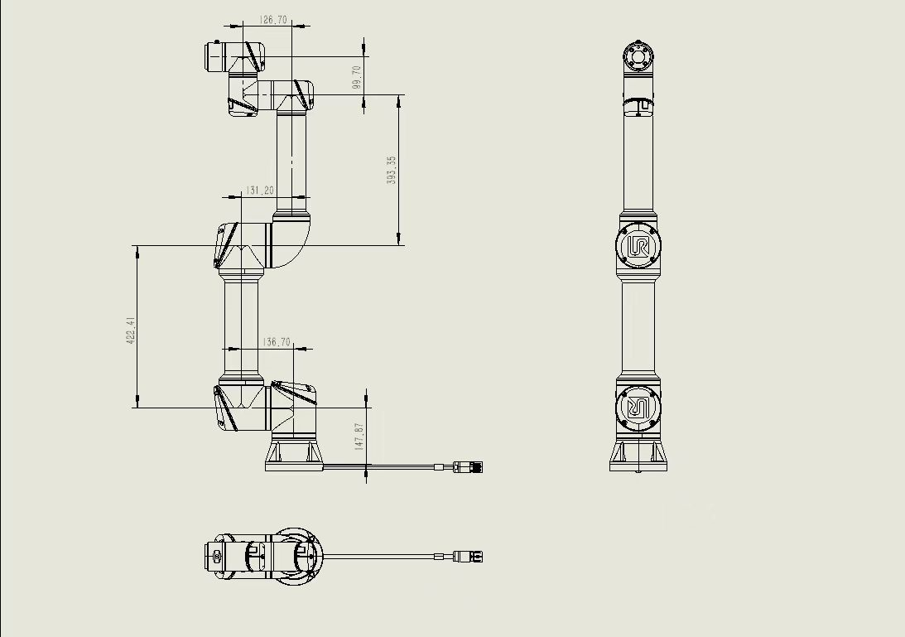
The Coordinate Frames
The Kinematic Parameters
Z₅
Link | θ | d | a | α
1 | θ1+π/2 | 147.87 | 0 | -π/2
2 | θ2-π/2 | 136.7 | 422.41 | 0
3 | θ3 | -131.2 | 393.35 | 0
4 | θ4+π/2 | 126.7 | 0 | π/2
5 | θ5 | 99.7 | 0 | -π/2
6 | θ6 | d6 | 0 | 0
Z₆
Y₅
X₃
Y₆
Z₄
Y₄
Z₃
X₂
X₂
Z₂
Z₂
Z₁
Y₁
Z₀
X₀

Slide 12
The Arm Equations
si=sin(θ_{i})
ci=cos(θ_{i})
i=1,2,3,4,5,6
R11=-c6s1s5-c5c4c1c2c3-c1s2s3-s4c1c2s3+c1c3s2-s6c4c1c2s3+c1c3s2+s4c1c2c3-c1s2s3
R21=c6c1s5-c5c4s1s2s3-c2c3s1+s4c2s1s3+c3s1s2-s6c4c2s1s3+c3s1s2-s4s1s2s3-c2c3s1
R31=-s6c4c2c3-s2s3-s4c2s3+c3s2-c5c6c4c2s3+c3s2+s4c2c3-s2s3
R12=s6s1s5-c5c4cos(ho1c2c3-c1s2s3-s4c1c2s3+c1c3s2-c6c4c1c2s3+c1c3s2+s4c1c2c3-c1s2s3
R22=-s6c1s5-c5c4s1s2s3-c2c3s1+s4c2s1s3+c3s1s2-c6c4c2s1s3+c3s1s2-s4s1s2s3-c2c3s1
R32=c5s6c4c2s3+c3s2+s4c2c3-s2s3-c6c4c2c3-s2s3-s4c2s3+c3s2
R13=-c5s1-s5c4c1c2c3-c1s2s3-s4c1c2s3+c1c3s2
R23=c1c5+s5c4s1s2s3-c2c3s1+s4c2s1s3+c3s1s2
R33=s5c4c2s3+c3s2+s4c2c3-s2s3
PX=d5c4c1c2s3+c1c3s2+s4c1c2c3-c1s2s3-d3s1-d4s1-d6c5s1+s5c4c1c2c3-c1s2s3-s4c1c2s3+c1c3s2-d2s1+a2c1c2+a3c1c2c3-a3c1s2s3
PY=d5c4c2s1s3+c3s1s2-s4s1s2s3-c2c3s1+d2c1+d3c1+d4c1+d6c1c5+s5c4s1s2s3-c2c3s1+s4c2s1s3+c3s1s2+a2c2s1+a3c2c3s1-a3s1s2s3
PZ=d1-a2s2+d5c4c2c3-s2s3-s4c2s3+c3s2-a3c2s3-a3c3s2+d6s5c4c2s3+c3s2+s4c2c3-s2s3

Slide 13
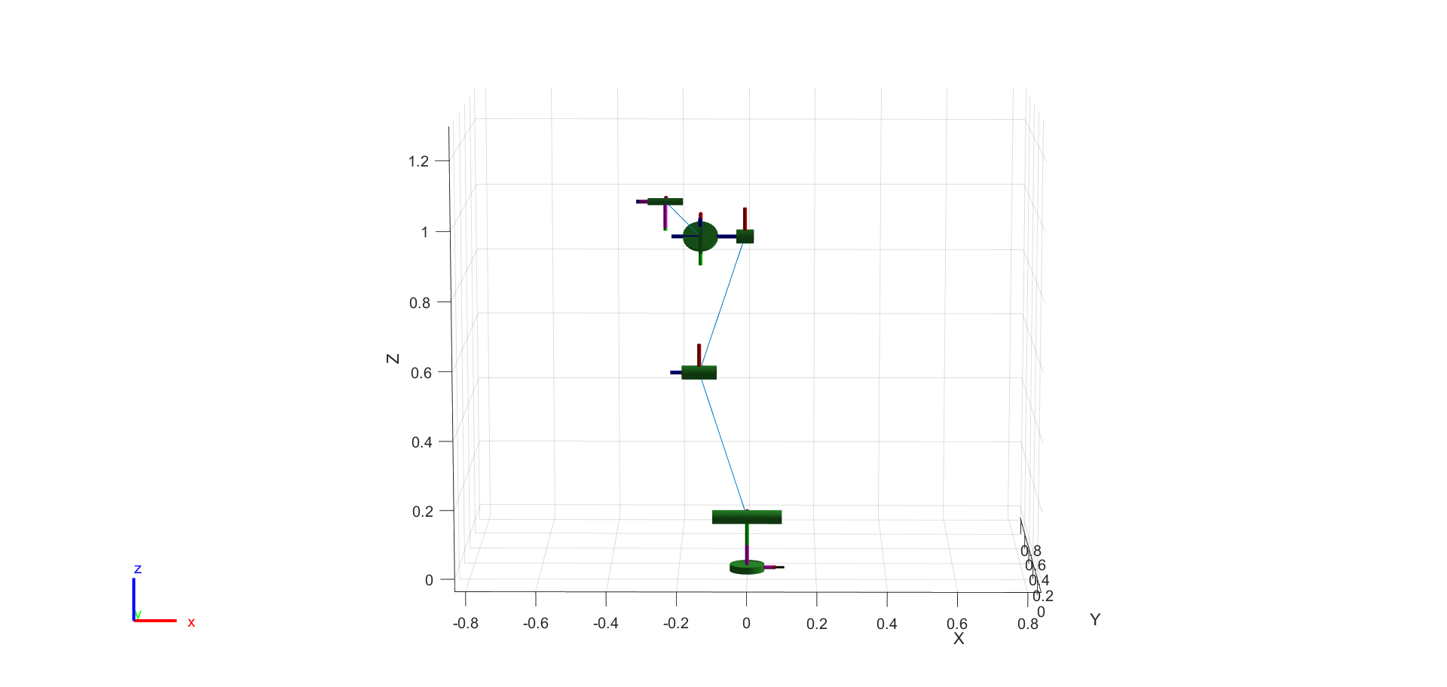
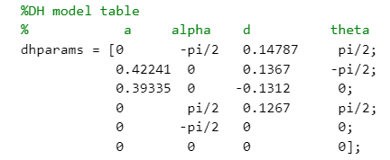
Matlab

Slide 14
Assembly
Process
PartThree

Slide 15
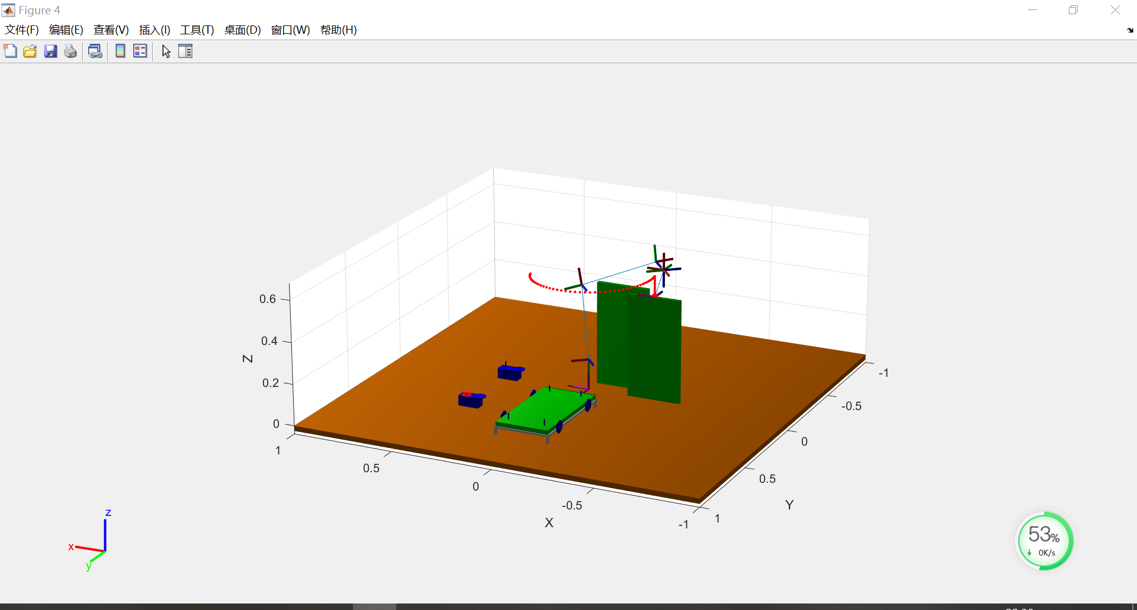
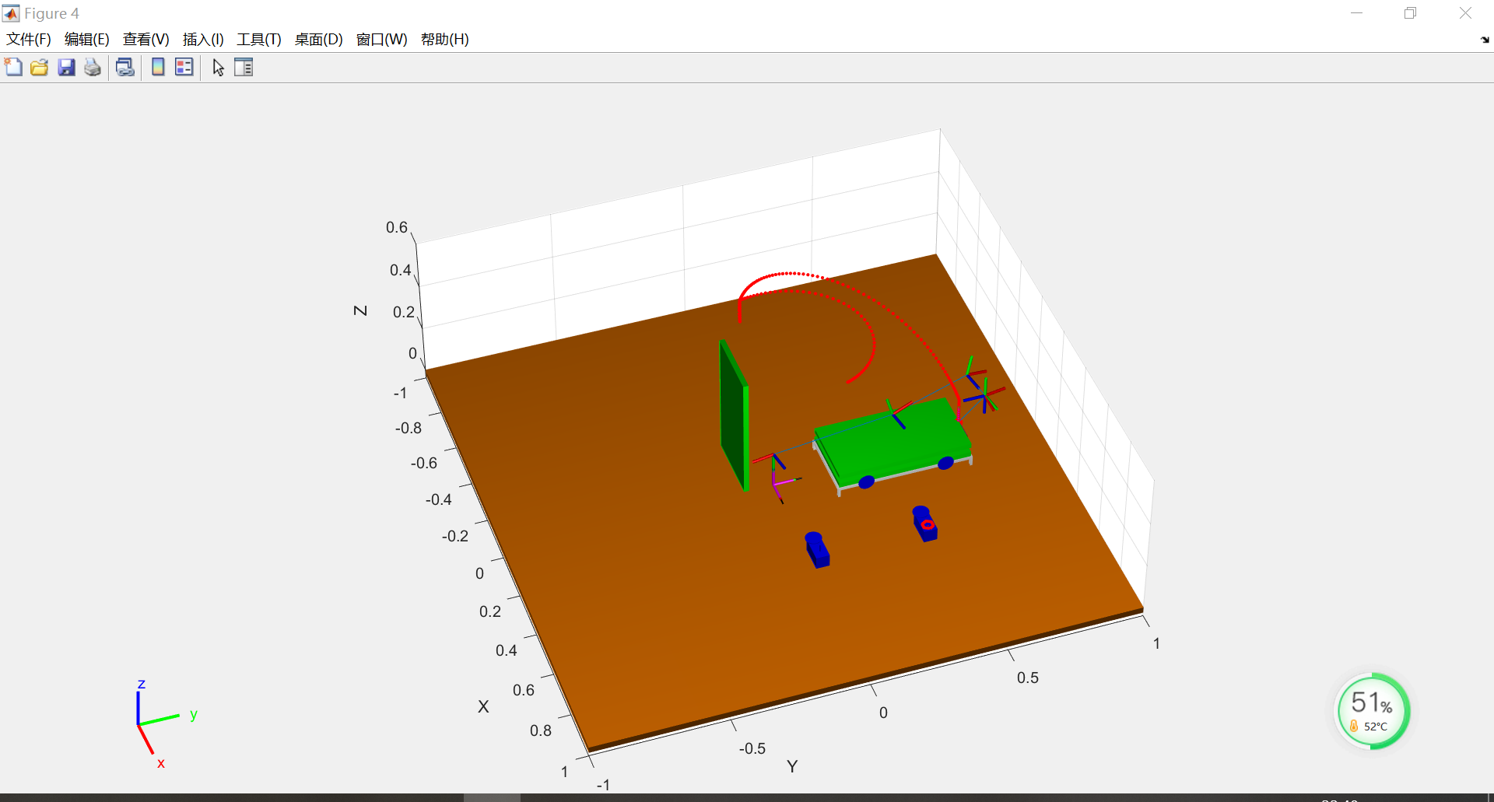
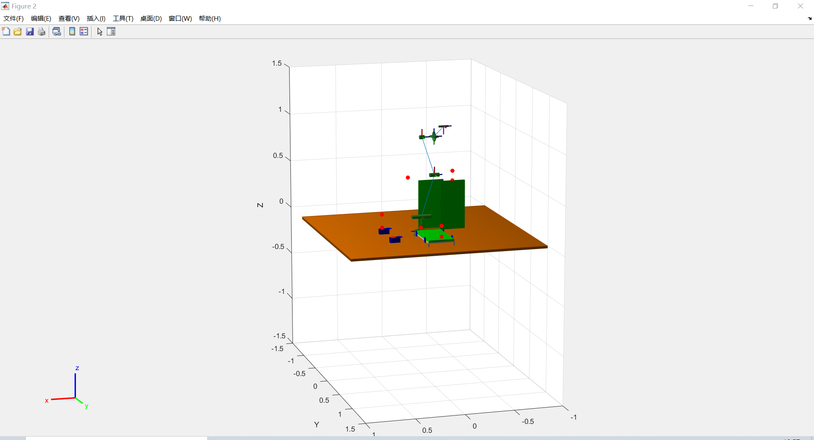
The configuraions of Task 1
The initial point of task one
Initial Point
Final Point
 | Joint1 | Joint2 | Joint3 | Joint4 | Joint5 | Joint6
Initial point | 0.7109 | -1.4040 | -1.6480 | 1.4812 | 1.5708 | 2.2817
Final point | -1.4047 | -2.8442 | -0.5072 | 0.2098 | 1.7369 | 0
The final point of task one

Slide 16
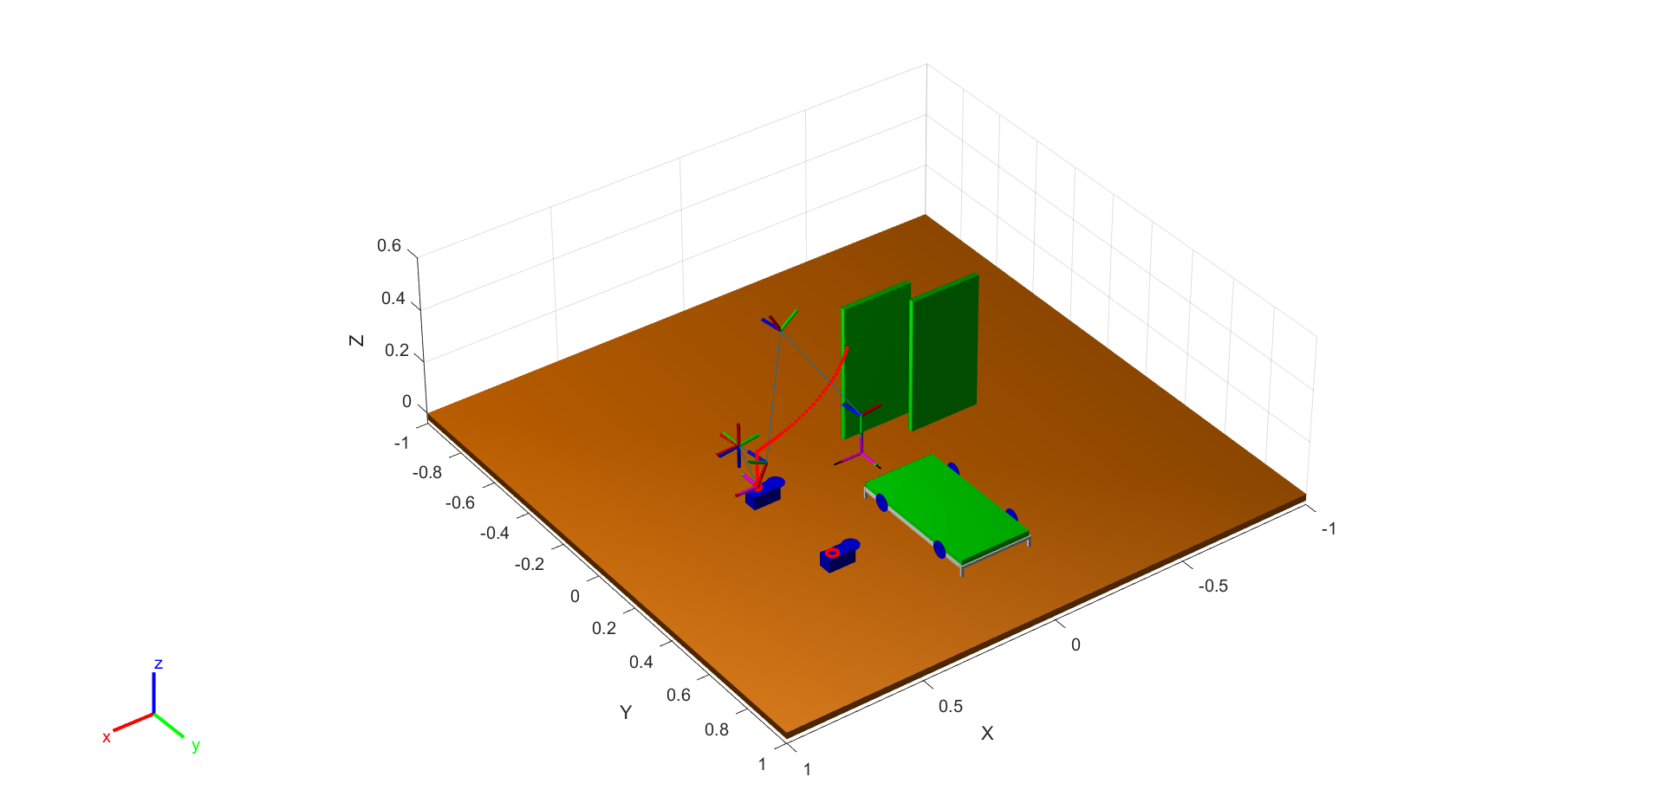
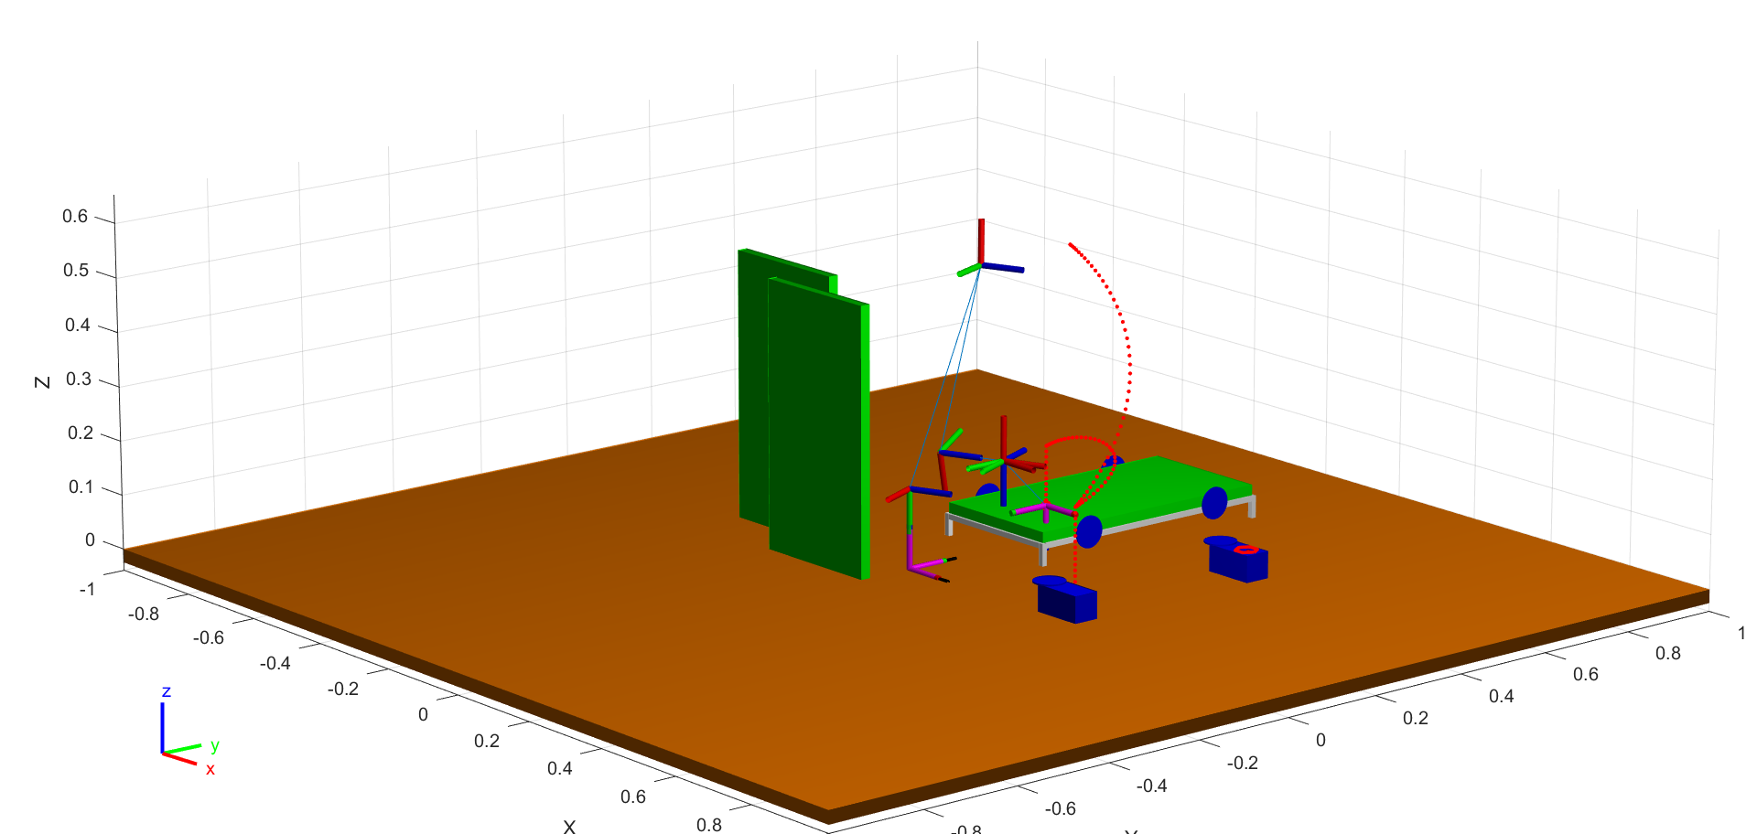
The configuraions of Task3
Home
Final Point
Initial Point
The initial point of task 3
 | Joint1 | Joint2 | Joint3 | Joint4 | Joint5 | Joint6
Initial point | -3.0025 | -2.1115 | -2.1021 | 2.6428 | 1.5708 | -1.4317
Final oint | -1.1709 | -1.5897 | -2.8674 | 2.8863 | 1.5708 | 0.3999
The final point of task 3

Slide 17
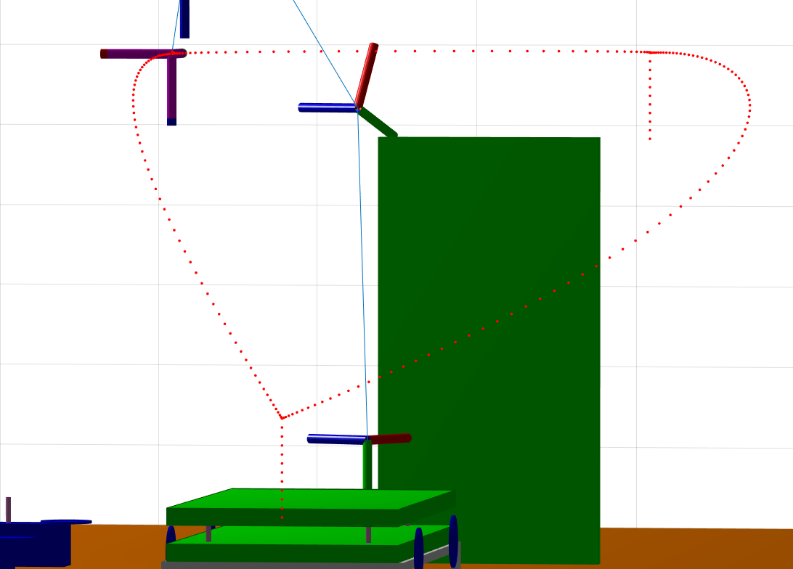
Path Planning
Task3 tool open
Home
Home
Task1 tool
open
Task3 initial piont
Task1 initial piont
Task1 final piont
Task3 final piont

Slide 18
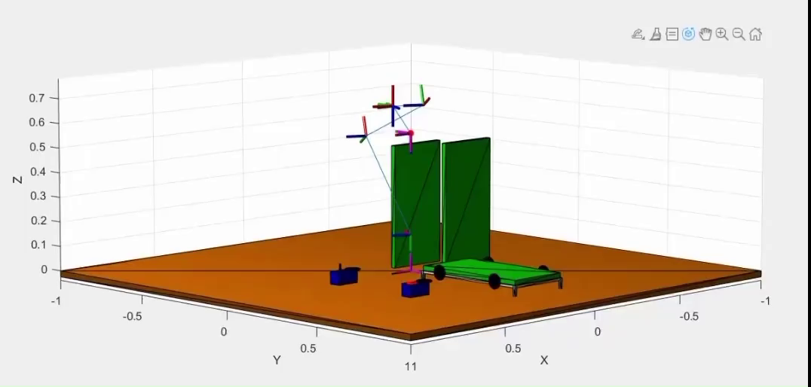
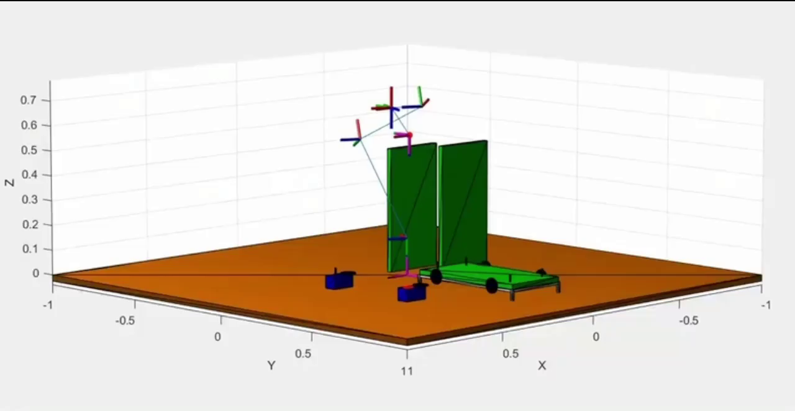
Transition of Task1
Transition of Task3

Slide 19
Thanks
UR5e
GROUP5

